Slide 1


Space Website

Slide 2

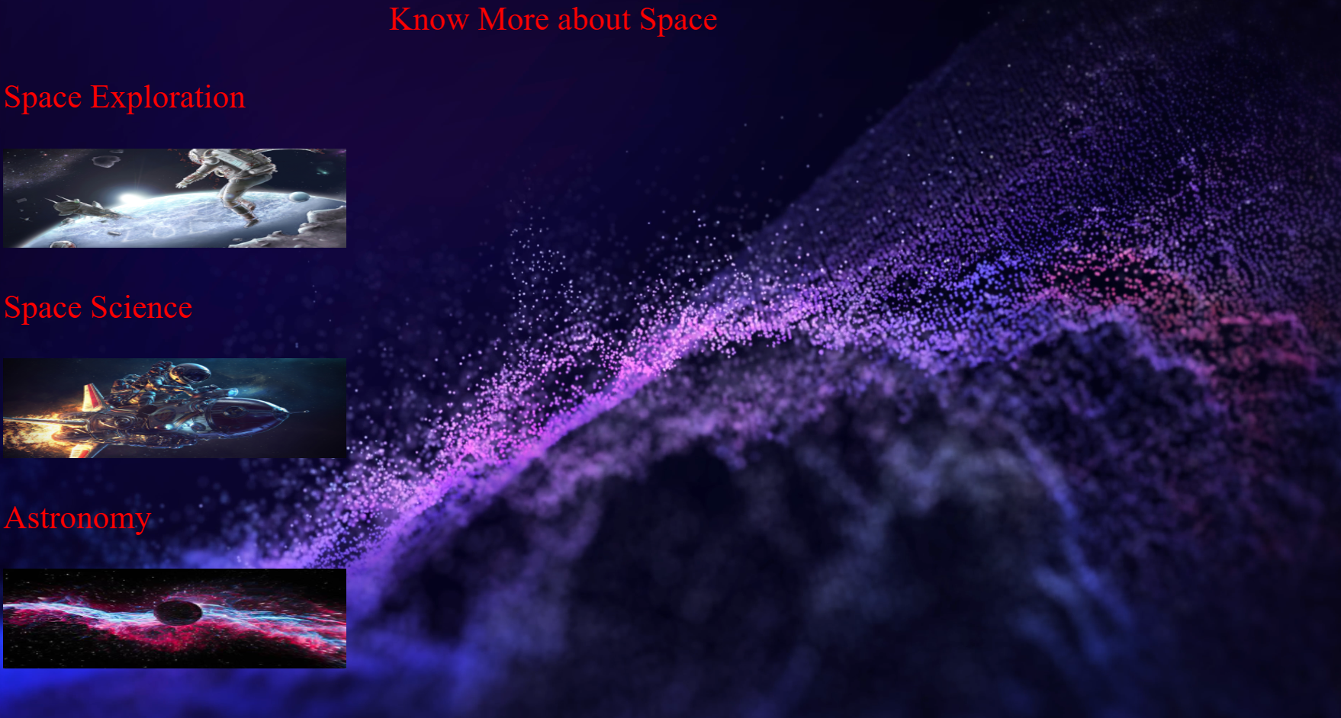
Home page
It is a basic interface with video background
And this when pictures takes you to their respective pages

Slide 3

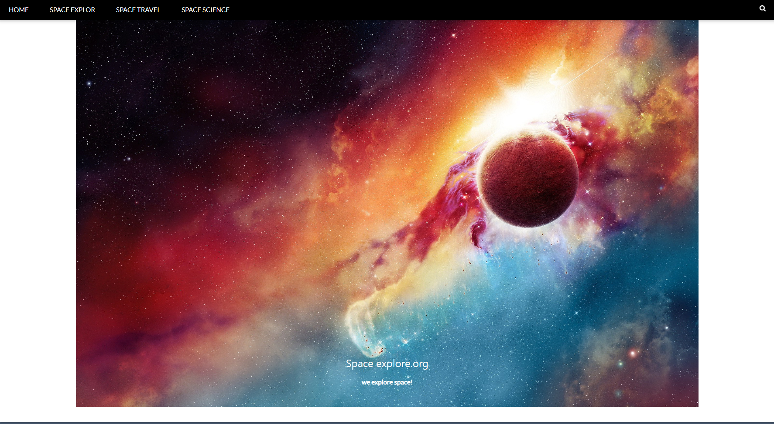
Space exploration
Here it shows
shows pic in slide
Ad you can check photos Here!!!

Slide 4
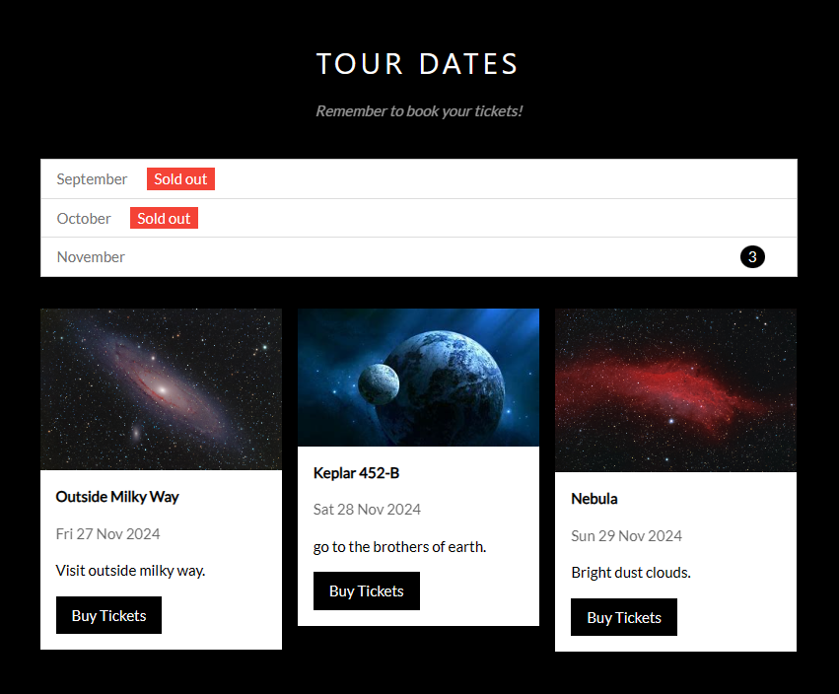
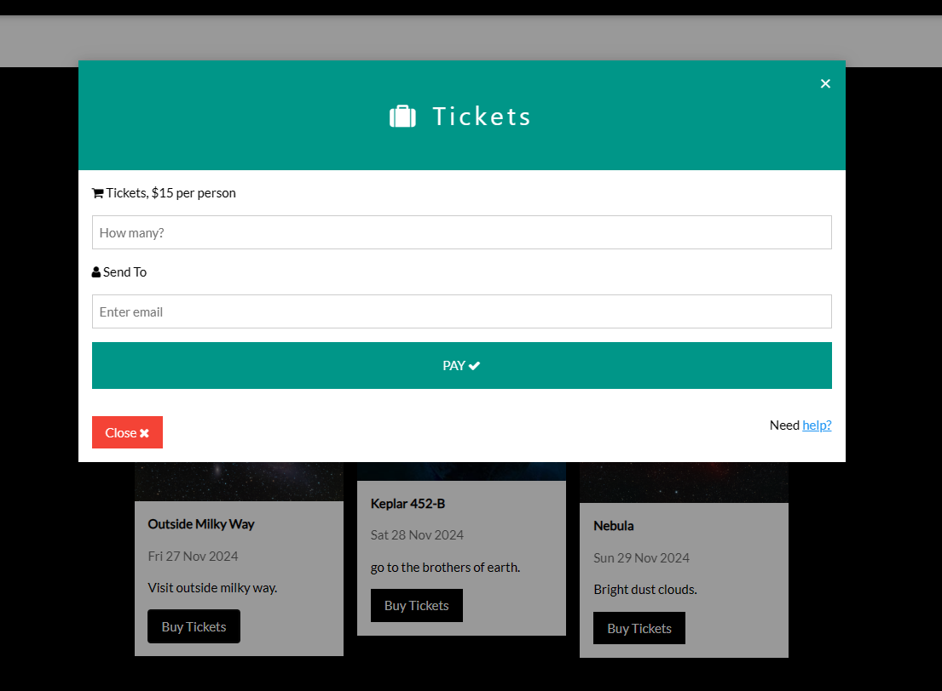
Ticket page and payout options
You can buy tickets here

Slide 5
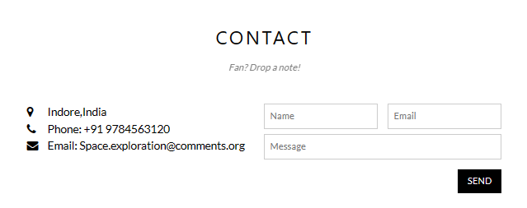

Contact us
You can contact us here

Slide 6
THANK YOU
Made By
Tanmay Shinde & Shubh Sachdev

